Slide 1
Cyber Physical Systems
This lecture is mainly based on the powerpoint slides by Prof. Mark Stamp, Prof. Lawrie Brown, Dr. Junjie Zhang, Mr. Vance Sanders

Slide 2
NSF’s definition of Cyber-Physical Systems
Cyber-physical systems (CPS) are engineered systems that are
built from, and depend upon, the seamless integration of
computation and physical components.
Advances in CPS will enable capability, adaptability,
scalability, resiliency, safety, security, and usability that will
expand the horizons of these critical systems.
CPS technologies are transforming the way people interact
with engineered systems, just as the Internet has transformed
the way people interact with information.
Notes:
Diverse, a variety of CPS.

Slide 3
NSF’s definition of Cyber-Physical Systems

Slide 4
What is a sensor? An actuator?
A sensor is a device that measures a physical quantity
Input / “Read from physical world”
An actuator is a device that modifies a physical quantity
Output / “Write to physical world”
Sensors: Cameras, Microphones, Magnetometers, Radar/Lidar, Chemical sensors, Pressure sensors, Switches
Actuators: Motor controllers, LEDs, lasers, LCD and plasma displays, Loudspeakers, Switches, Valves
Notes:
Sensors: Cameras, Microphones, Magnetometers, Radar/Lidar, Chemical sensors, Pressure sensors, Switches
Actuators: Motor controllers, LEDs, lasers, LCD and plasma displays, Loudspeakers, Switches, Valves

Slide 5
Cyber-Physical Systems
Cyber-Physical Systems (CPS) comprise interacting digital, analog, physical, and human components engineered for function through integrated physics and logic.
Examples include a smart gird, a self-driving car, a smart manufacturing plant, an intelligent transportation system, a smart city, and Internet of Things (IoT) instances connecting new devices for new data streams and new applications.
Common notions of IoT have emphasized networked sensors providing data streams to applications.
CPS concepts complete these IoT notions, providing the means for conceptualizing, realizing and assuring all aspects of the composed systems of which sensors and data streams are components.
The Framework for Cyber-Physical Systems was released by the NIST CPSPWG on May 26, 2016

Slide 6
Cyber-Physical Systems
As per the book : “ Introduction to Embedded Systems: A Cyber-Physical Systems Approach by Edward A. Lee and Sanjit Arunkumar Seshia ”
A cyber-physical system (CPS) is an integration of computation with physical processes. Embedded computers and networks monitor and control the physical processes, usually with feedback loops where physical processes affect computations and vice versa. As an intellectual challenge, CPS is about the intersection, not the union, of the physical and the cyber. It is not sufficient to separately understand the physical components and the computational components. We must instead understand their interaction.

Slide 7
Cyber-Physical Systems
In simple terms cyber-physical system is interconnection of cyber means virtual and physical means real systems. It uses three basic technologies which are Embedded Systems, Sensor and actuation ,and Network and communication System(IOT). In layman's term CPS is something which takes real time data smartly from Physical System and its environment with help of Sensors and then gives real time signal command to the actuator part to do desired work. Smart Home, Smart Grid are best example of this.

Slide 8
CPS and IoT
Cyber-Physical systems are devices which tightly couple cyber (digital) computer with a physical system (mechanical parts) where the digital computer acts as a controller for the physical system. For example, a printer has both mechanical parts and digital controller inside it therefore it can be considered an example for a cyber-physical system. Other examples include cars, medical devices and aeroplanes. Cyber-physical systems are not necessary connected to each other.
Internet of Things refers to unique identifiable and Internet-connected embedded systems.
Cyber Physical Systems that are uniquely identifiable and can communicate through the internet are some examples of IoT.

Slide 9
CPS and IoT
Cyber-Physical Systems (CPS) comprise interacting digital, analog, physical, and human components engineered for function through integrated physics and logic.
Examples of a CPS that are not instances of IoT
Smart Spoon enabling Parkinson’s patients to feed themselves (see https://www.liftware.com/)
Autonomous vehicle operating without wired or wireless connections outside the vehicle, e.g.
a Mars rover operating between messages from Earth
the original vehicles in the first DARPA Challenge
cruise missile/smart bomb in flight to target
Generally, any CPS that is fully contained with no outside network connections

Slide 10
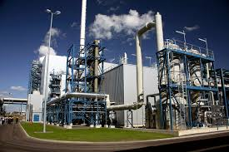



CPS vs. IoT: Motion Activated Light
CPS
IoT Scope of Research
OUTs
Communication
Channel
(Network)
INs
Sensors
Aggregator
(Fusion)
Computation
(e-utility)
Decision
(Software)
Actuators
INs
OUTs
Model of Motion
Physical Interaction
Logical Interaction
Framework Schema: Phys-Log-Log-Log-Log-Phys
Testbed: Experiment, Measurement and Assurance
Challenges: Interoperability, Composition and Composition Types, Trustworthiness, etc.
Notes:
Complexity and Diversity of the CPS

Slide 11
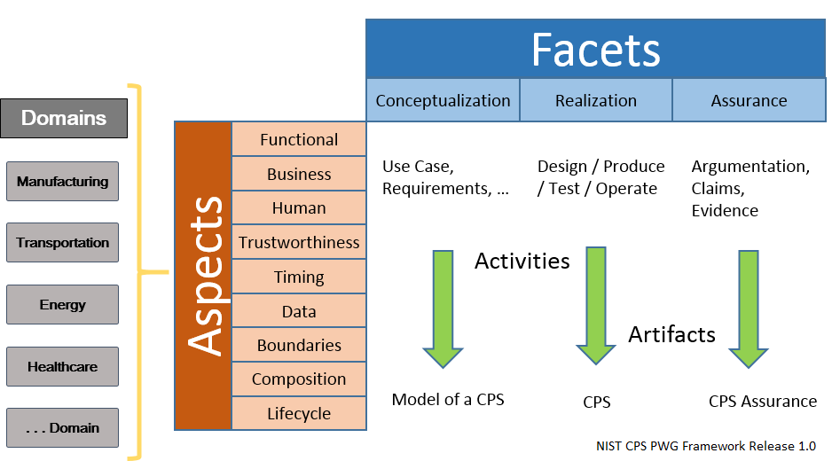
CPS Framework
Notes:
Functional: work as expected functionality
Business: cost
Human: new
Trustworthiness: the hardware (fabricated somewhere else)/software module (developed somewhere else), can you trust them?
Timing: real time constraint
Data:
Composition: Individual components work as expected (tested). Integrate or assembly different components together, will the system perform as expected?
Boundary: within a system, or a connected system
Composition: Individual components work fine. When they are integrated (assembled) together, problems might arise.
Lifecycle:

Slide 12
Application Domains – major societal impact
Agriculture, Aeronautics, Building design, Civil
infrastructure, energy, environmental quality, healthcare and personalized medicine, Manufacturing, and transportation.

Slide 13
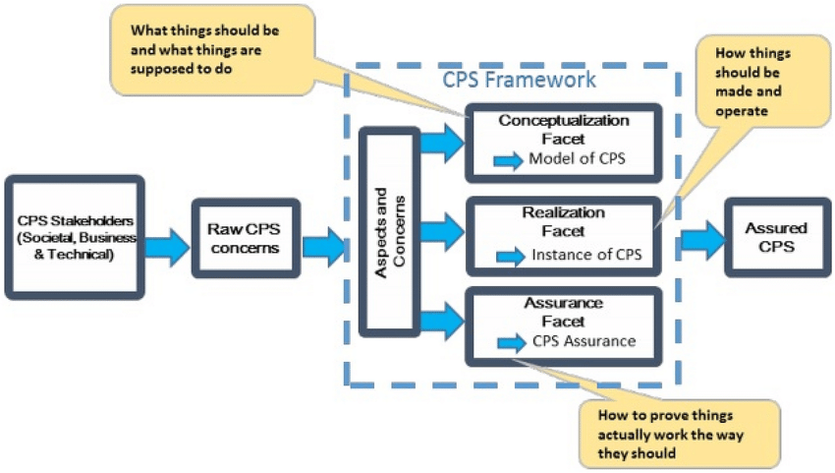
CPS Framework
Notes:
Modeling is the process of gaining a deeper understanding
of a system through imitation. Models specify what a system
does.
Design is the structured creation of artifacts. It specifies how
a system does what it does. This includes optimization.
Analysis is the process of gaining a deeper understanding of
a system through dissection. It specifies why a system does
what it does (or fails to do what a model says it should do).

Slide 14
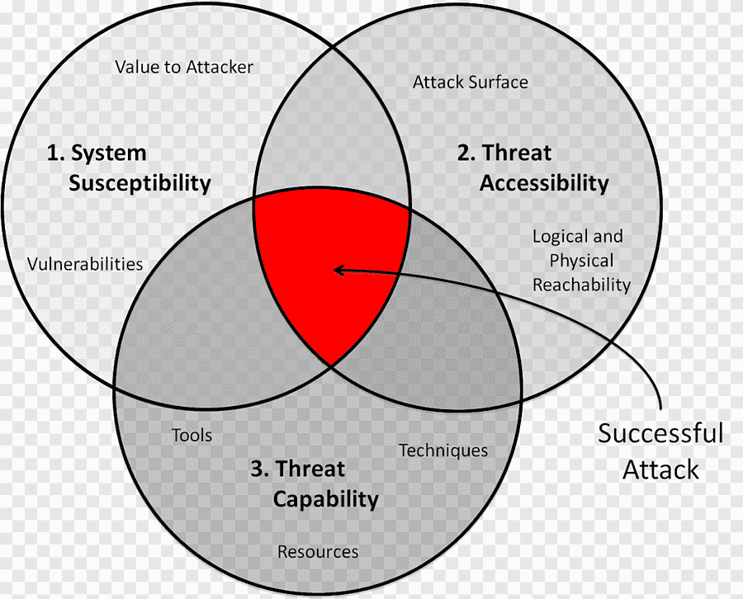
Methodology initially developed at AFAR
Three Tenets-reduce a System’s vulnerability by:
Focus on what is critical – reduce the number of potential susceptibility points
Move It 'Out of Band' – make the critical pieces less accessible (or inaccessible)
Detect, React, Adapt – deny the threat the ability to do harm (get inside the adversary’s OODA loop)
The Methodology is sound – now need to research & develop the processes, tools & technologies to efficiently implement the methodology
Notes:
Unique, cost effective Methodology initially developed at AFIT
Total system approach, focused on mission assurance, using a unique,validated analysis methodology

Slide 15
Methodology initially developed at AFAR
System Susceptibility
System Specific Engineer – expert knowledge of subsystems/component functionality
Reverse Engineer – expert on determining critical system functionality and possible exploits of that functionality
2. Threat Accessibility
Penetration Tester – expert knowledge of how to “penetrate”/gain access to a system using “Total Weapons System” approach
3. Threat Capability
Intelligence Analyst – expert knowledge of threat capabilities
4. Mission Assurance
Mission Expert – operations expert that knows how the system is used in a mission context
Mission Assurance
Notes:
Unique, cost effective Methodology initially developed at AFIT
Total system approach, focused on mission assurance, using a unique,validated analysis methodology

Slide 16
Military Std 1553 Data Bus
MIL-STD-1553is a military standard published by the United States Department of Defense that defines the mechanical, electrical, and functional characteristics of a serial data bus.
It was originally designed for use with military avionics, but has also become commonly used in space craft on-board data handling (OBDH) subsystems, both military and civil
It features a dual redundant balanced line physical layer, a (differential) network interface, time division multiplexing, half-duplex command/response protocol, and up to 31 remote terminals(devices).
Aversion of MIL-STD-1553 using optical cabling in place of electrical is known as MIL-STD-1773.
MIL-STD-1553 was first published as a U.S. AirForce standard in1973,and firstwas used on the F-16 Falcon fighter aircraft
Other air craft designs quickly followed, including the F-18 Hornet, AH-64 Apache, P-3 COrion, F-15 Eagle and F-20 Tigershark.
It now is widely used by all branches of the U.S. military and has been adopted by NATO as STANAG 3838 AVS
The Russian made MiG-35 also uses MIL-STD-1553
MIL-STD-1553 is being replaced on some newer U.S. designs by IEEE1394 (aka FireWire)
Notes:
Bus - common backbone connects all devices (No access control, so confidentiality, integrity, availability can be compromised)

Slide 17
AIT MIL-STD-1553 Single-,Dual-,and Quad-Channel MIL-STD-1553 PXI Modules
1, 2, or 4 dual redundant MIL-STD-1553 bus interfaces with full error injection and detection
Concurrent BC, multiple RT(31),and BM operations for extended function interfaces
On board time tag clock synchronization to external IRIG or PXI system clock
PXI trigger input / output support (generate PXI triggers on 1553 bus events)
PCI extensions for instrumentation - spec defines a rugged PC-based platform for measurement & automation systems
Variable output voltage signal and software-selectable bus coupling modes
Advanced driver for developing applications in LabVIEW, LabVIEW Real-Time,and Windows-based C/C++
Notes:
MIL-STD-1553: real time requirement
Bus - common backbone connects all devices (No access control, so confidentiality, integrity, availability can be compromised)
Single cable backbone -shared communication medium
All devices attach or tap into with an interface connector
All messages are broadcast onto the wire that all other devices see, only the intended recipient acts on it

Slide 18
System Vulnerability Model Expanded
Notes:
Attack Graph (Attack Tree)
Bus - common backbone connects all devices (No access control, so confidentiality, integrity, availability can be compromised)
Single cable backbone -shared communication medium
All devices attach or tap into with an interface connector
All messages are broadcast onto the wire that all other devices see, only the intended recipient acts on it

Slide 19
CPS Analysis & Testing Environments
Electronic Control Unit (ECU)
Controller Area Network (CAN)
Found in virtually all modern cars since ~2003
Some modern cars have over 80 ECUs in the CAN
Notes:
On-Board Diagnostics (OBD port to diagnose the car)

Slide 20
Hacking an Airplane With Only an Android Phone
At the Hack In The Box conference in Amsterdam, security consultant Hugo Teso demonstrated Plane Sploit
An app he developed that he claims can take control of certain systems aboard an airplane and cause it to change direction or just crash itself into the ground.
Hugo’s no terrorist - he developed the app to point out the glaring, frightening, insane security holes in most planes’ onboard flight systems
His demonstration was done in a simulated environment, but the methods and effects, he says, are exactly the same as what could happen with a real plane.
“The complete attack will be accomplished remotely, without needing physical access to the target aircraft at any time,” wrote Teso in his presentation abstract for the conference
The hack exploits the plane’s autopilot, transferring control to the hacker, who(in theory) could command the plane from an app running on Android.

Slide 21
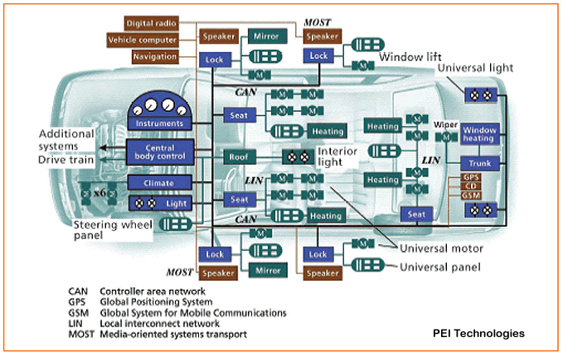
The Modern Automobile
Electronic Control Unit (ECU)
Controller Area Network (CAN)
Found in virtually all modern cars since ~2003
Some modern cars have over 80 ECUs in the CAN
Notes:
On-Board Diagnostics
When phones can be connected to the multi-media system or the GPS system of the car, the car become vulnerable

Slide 22
Before CAN
Notes:
Point to point communication

Slide 23
Controller Area Network
Developed by BOSCH as a multi-master, message broadcast system
Many short messages are broadcast to the entire network, which provides for data consistency in every node of the system
CAN is an important embedded protocol
Primarily automotive, but used in many other places
CAN specifies:
Physical layer
Protocol layer
Message filtering layer (with add-on protocols)
Note
How message prioritization achieved
How “small” nodes can be kept from overloading with received messages
Notes:
Bus - common backbone connects all devices
Single cable backbone -shared communication medium
All devices attach or tap into with an interface connector
All messages are broadcast onto the wire that all other devices see, only the intended recipient acts on it
Best with a limited number of devices ... more than a few dozen causes performance problems
If the backbone cable fails, the entire network fails

Slide 24
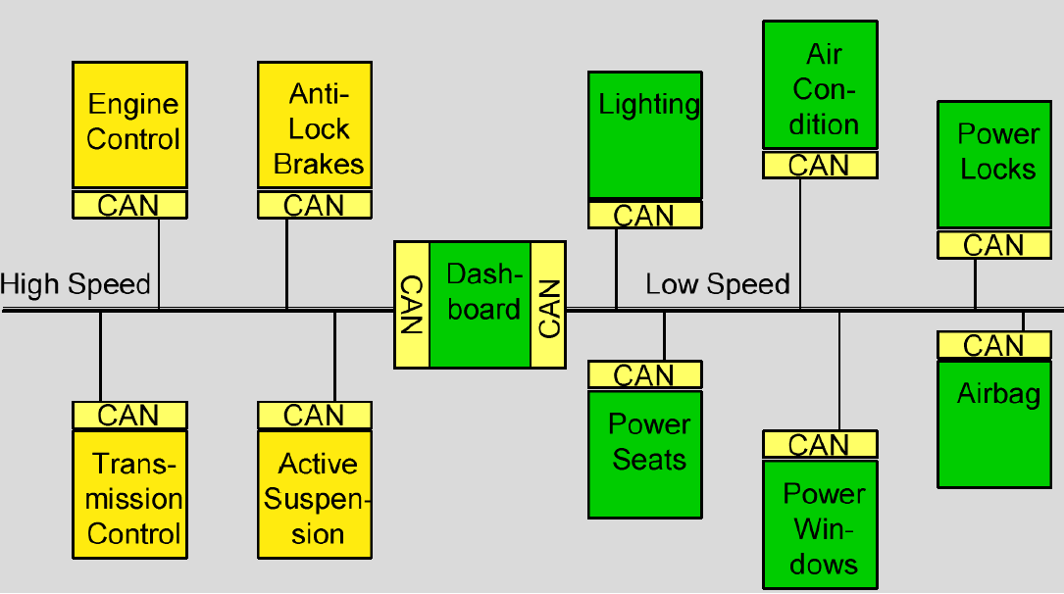
CAN Bus
The solution to this problem was the connection of the control systems via a serial bus system. This bus had to fulfill some special requirements due to its usage in a vehicle. With the use of CAN, point-to-point wiring is replaced by one serial bus connecting all control systems. This is accomplished by adding some CAN-specific hardware to each control unit that provides the "rules" or the protocol for transmitting and receiving information via the bus.
Notes:
CAN (Controller Area Network) developed in 1980s for automotive applications
CAN controller & transceiver chips are reasonably priced due to high quantities required in the automotive industry. These facts have made it attractive to developers of non-automotive systems
Rail vehicles - CAN-based systems are used to connect control devices, sensors or drives.
CAN bus used in space systems of several different countries including the U.S.

Slide 25
CAN Bus
Notes:
CAN defines physical and data link layers (Layer1 and 2 of the 7-layer OSI reference model)
A higher layer protocol was required (e.g. like TCP was needed for IP)
CAN open is a CAN-based higher layer protocol that was developed as a standardized embedded network with highly flexible configuration capabilities
CAN Protocol:
No addresses – uses publish & subscribe communications model
CAN ID header indicates packet type
All packets broadcast to all nodes
Each node determines whether or not to process the packet(s)

Slide 26
Auto mobile Hacks & Defenses - Some Examples
On-Board Diagnostics (OBD-II) port
THE HACK: The researchers at CAESS wrote and then installed a program onto the car’s CAN bus through the OBD-II port. Once on the network, the program could control every system from the wind shield wipers to the brakes. This is the most direct way to hack a car, as it sends code directly to the CAN bus.
THE DEFENSE: Car makers are starting to adopt routine security protocols from the information-technology field, such as protecting files with digital signatures.
“What’s pretty much standard IT is now being applied to the automotive sector,” says Gassenfeit.
Notes:
When phones can be connected to the multi-media system or the GPS system of the car, the car become vulnerable

Slide 27
The automobile - Hacked
Charlie Miller, Chris Valasek
This story appears in the August 12, 2013 issue of Forbes.
Notes:
Separation of Network - Different Can Buses separated with Gateways

Slide 28
The Problem
CAN is an insecure low-level protocol
Every message is an unencrypted plain-text broadcasted to every device on the CAN
Possible messages and communication procedures are often documented and made available freely
No component authentication
Any device can send a command to any other devices.
Attacker could use tire pressure gauge to turn off brakes

Slide 29
The Solutions

Slide 30
The Solutions
The Linux kernel runs in an area of system memory called the kernel space
Regular user applications run in an area of system memory called user space
A hard boundary between these two spaces prevents
User applications from accessing memory and resources required by the Linux kernel
Linux kernel from crashing due to badly written user code
Interfering one user’s applications with another

Slide 31
The Solutions
Severity
Functional Safety
Hazard
Frequency
Safety
Controllability
CPS Function
Confidentiality
Encryption
AES
Reliability
Integrity
Availability
Cyber Security
Trustworthiness
Security
SME Taxonomies
Physical Security
Resilience
Controls
Authorization
OAuth
Predictability
Transparency
Privacy
Manageability
Innovation
Function/Feature
Apply Aspects/Concerns
Generate
‘Properties’
Dissociability
A secure, privacy protected CAN BUS Message may consist of these properties: {Trustworthiness.Security.Cybersecurity.Confidentiality.Encryption.AES, Trustworthiness.Privacy.Predictability.Controls.Authorization.OAuth}

Slide 32
The Solutions
Auto manufacturers need to recognize this security flaw in the CAM if they are using wireless ECU communication
Controller authentication
Only valid controllers can communicate on the CAN
Encrypted communication
Must be high performance, so use symmetric key
Distribute symmetric key using asymmetric encryption during authentication
Firewall
Restrict a components commands to only those essential to its function

